Slide 1
Lesson 1
Introduction to PL/SQL

Slide 2
Objective
In this lesson we will cover the following :
  Discuss the goals of the course
  Describe the HR database schema that is used in this course
  Identify the available user interface environments that can be used in this course
  Reference the available appendixes, documentation, and other resources

Slide 3
Lesson Agenda
  Course objectives and course agenda
  The schema and appendixes used in this course
Overview of Database used and related products
  Available PL/SQL development environments
  documentation and additional resources

Slide 4
Course objectives and course agenda
  Identify the programming extensions that PL/SQL provides to SQL
  Design PL/SQL anonymous blocks that execute efficiently
  Handle runtime errors
  Describe stored procedures and functions
Notes:
Java SE 8 Programming 2 - <number>

Slide 5







Human Resources (HR) Schema for This Course
DEPARTMENTS
department_id
department_name
manager_id
location_id
LOCATIONS
location_id
street_address
postal_code
city
state_province
country_id
JOB_HISTORY
employee_id
start_date
end_date
job_id
department_id
EMPLOYEES
employee_id
first_name
last_name
email
phone_number
hire_date
job_id
salary
commission_pct
manager_id
department_id
COUNTRIES
country_id
country_name
region_id
JOBS
job_id
job_title
min_salary
max_salary
REGIONS
region_id
region_name

Slide 6
PL/SQL Development Environments
The course setup provides the following tools for developing PL/SQL code:
  Oracle SQL Developer (used in this course)
  Oracle SQL*Plus

Slide 7

Oracle SQL Developer
  Oracle SQL Developer is a free graphical tool that enhances productivity and simplifies database development tasks.
  You can connect to any target Oracle database schema by using standard Oracle database authentication.
  You use SQL Developer in this course.

Slide 8
Specifications of SQL Developer
  Is developed in Java
  Supports the Windows, Linux, and Mac OS X platforms
  Enables default connectivity by using the JDBC Thin driver
  Connects to Oracle Database version 9.2.0.1 and later
  Connects to Oracle Database on Cloud also

Slide 9
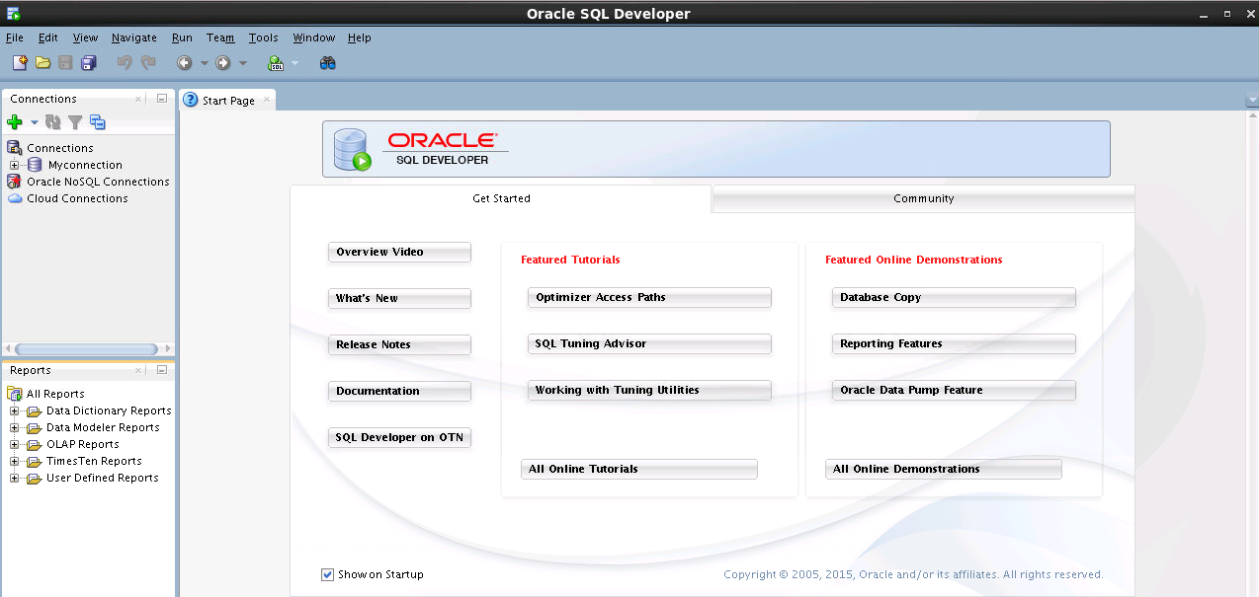
SQL Developer 4.1.3 Interface

Slide 10
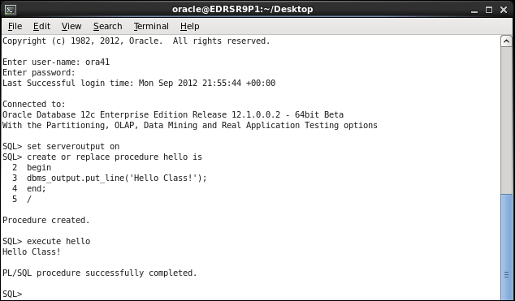


Coding PL/SQL in SQL*Plus

Slide 11
Additional Resources
For additional information about the new Oracle SQL and PL/SQL new features, refer to the following:
  Oracle Database: New Features self study
  What’s New in PL/SQL in Oracle Database on the Oracle Technology Network (OTN):
    http://www.oracle.com/technetwork/database/features/plsql/index.html

Slide 12
Summary
In this lesson we have covered the following :
  Discuss the goals of the course
  Describe the HR database schema that is used in the course
  Identify the available user interface environments that can be used in this course
  Reference the available appendixes, documentation, and other resources

